Slide 1
Power BI Adoption Framework
Empower every decision maker
Overview of the series

Slide 2
Introduction
Power BI can foster a data-driven culture
Opportunity
Challenge
Framework that acts as a wrapper around Power BI to drive a Data Driven Culture
Proposal
Self-Service BI adoption can be challenging

Slide 3
Why care about Power BI Adoption?
Data Culture
Agile BI Mindset
Consolidation of Tools

Slide 4
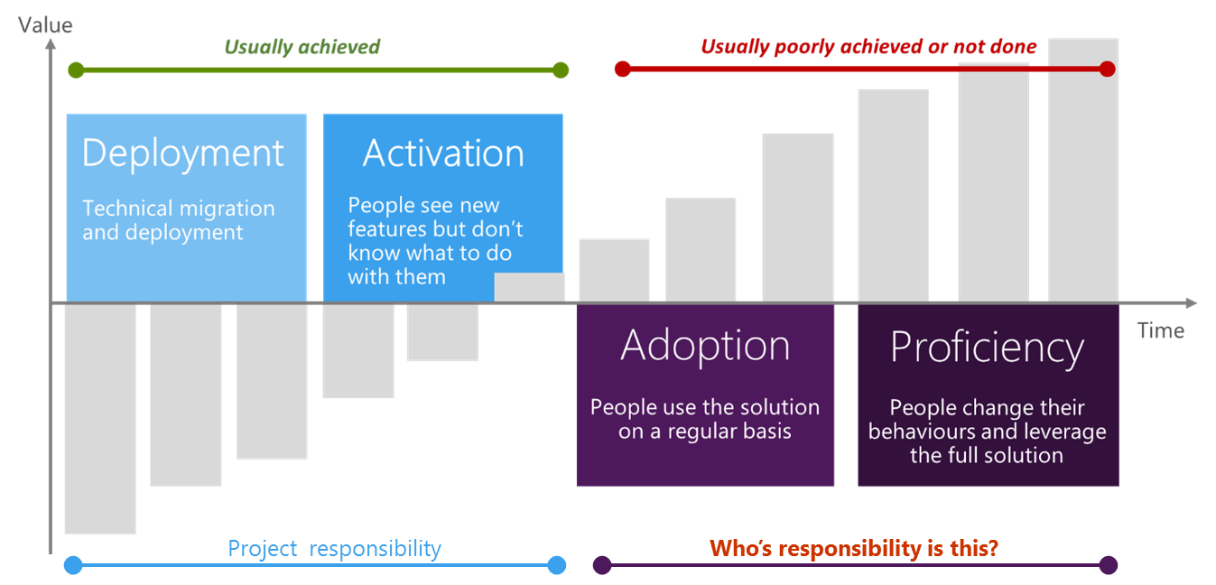
IT transformation is dependent on behaviour change…
…but behaviour change is DISCRETIONARY

Slide 5
Ongoing Value Adoption

Slide 6
Stages of Technology Adoption
Awareness
“Provide Context”
Understanding
“Create Momentum”
Enablement
“Increase knowledge,
Provide support”
Adoption
“Change Behaviours”

Slide 7

Data culture

Slide 8
What led to this series…
Customer Need
BI Champs
Customer & Partner Feedback
Power BI Whitepapers
Power BI Product Group
BI @ Microsoft

Slide 9

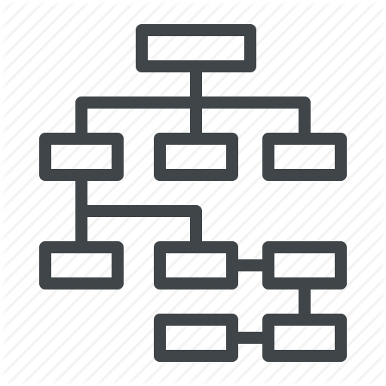







Learning from existing customers
Addressing Technical Issues
Clear BI Strategy
Plan
Exec Sponsor
User Community Profile
Data Quality
Compliance, Security, Governance
Infrastructure
Adoption Plan
Clear BI scenarios
Product Gaps
Centre of Excellence

Slide 10



Power BI Adoption Methodology
Envision
Educate Exec Sponsor
Identify Champions
Train pilot team
Prove value
On-board
Select a Project
Adoption workshop
Address data quality
Implement Project
Drive value
Centre of Excellence
End user training
Internal community
Internal marketing

Slide 11
Engagement Model
IT/Partner teaches business
Business teaches Business
50% Business
75% Business
90% Business
50% IT/Partner
25% IT/Partner
10% IT/Partner
Enablement
Support
Guidance

Slide 12
Adoption Framework Schedule
Workshops
Follow-up Discussions
`
Documentation
Plan

Slide 13
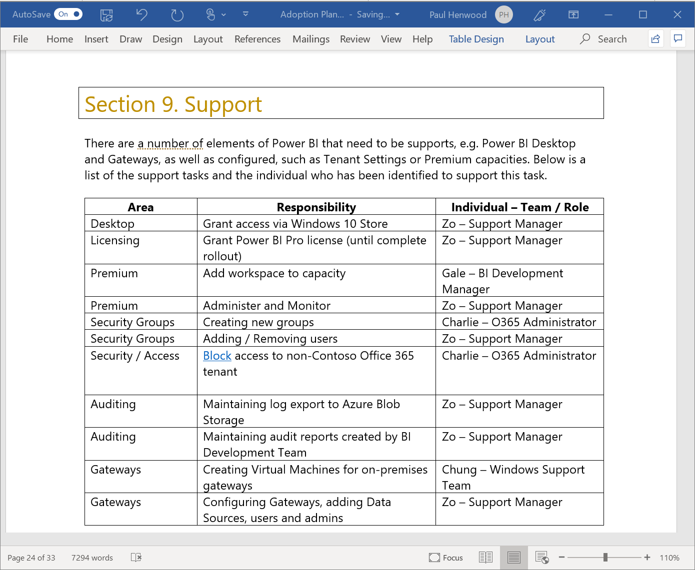
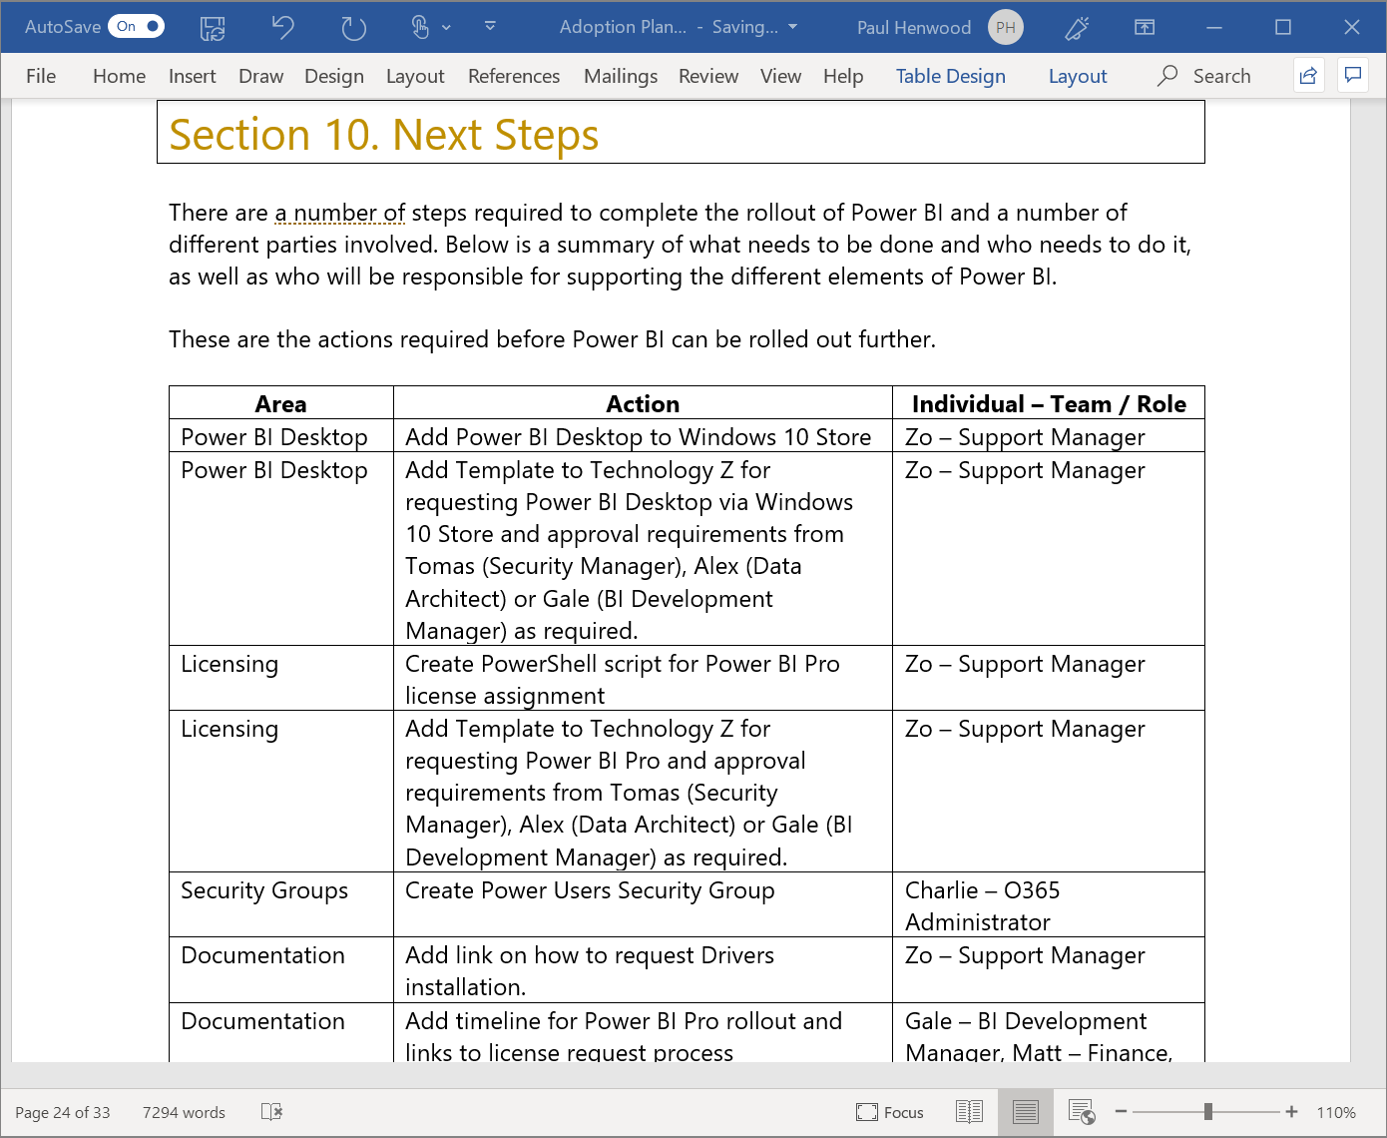
Adoption Framework - Outputs

